Slide 1



Slide 2
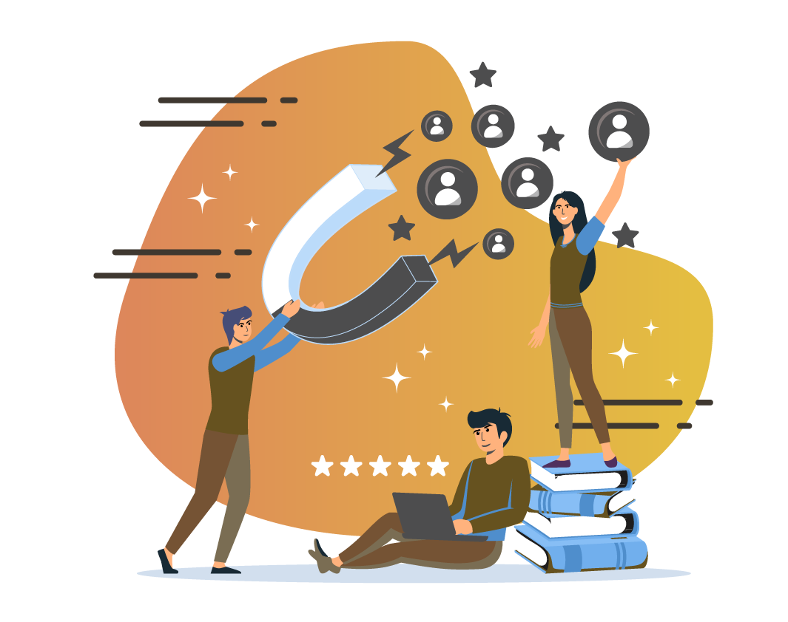
HR ANALYTICS-
EMPLOYEE
RETENTION
Project Presentation
Organization: ExcelR
Mentor: Dipti Sinha
Date: 21 Aug 2024
Presented By:
Shruti Mishra
Priya Reddy
Pranay Wani

Slide 3

Team Members
Sonali
Shinde
Namita Ratnaparkhi
Priya Reddy
Akshay Babhare
MySQL
MySQL
Excel
Excel
Pranay Wani
Shruti Mishra
Dinesh Shivaji
Power BI
Power BI
Tableau

Slide 4
Agenda:
Introduction & Objective
Timeline
Problem Statements
Data Sources
Tools Overview
Data Preparation
Data Analysis & Key Insights
Dashboards
Recommendations
Conclusion
Future Scope

Slide 5
Introduction & Objective
The purpose of HR Analytics is to collect and analyze HR-related data, including employee information, performance metrics and other relevant data points. In addition to providing valuable insights into HR processes & trends, it allows organizations to improve their overall performance by making more informed decisions about their employees.
Objective: The primary objective of this project is to leverage HR data to gain actionable insights into employee behaviour, performance, and satisfaction. The aim is to help the organization reduce attrition, enhance employee engagement, and optimize HR strategies.

Slide 6


Project Timeline
Week - 1
²⁰²⁴
Conducted initial data exploration & cleaning. Created Pivot Tables to identify trends and patterns in dataset. Developed complex queries to prepare data for further analysis.
MS Excel And MySQL
31 July 2024 04:45 PM

Slide 7


Week - 2
²⁰²⁴
Data Visualization: Transitioned cleaned & structured data into Tableau. Created interactive dashboard to show metrics like attrition, satisfaction score, work-life balance.
Tableau
07 Aug 2024 04:45 PM
Week - 3
²⁰²⁴
Used Power BI to enhance data analysis with more sophisticated visualizations. Created dynamic report. Focused on in-depth analysis of attrition and other key performance metrics.
Power BI
14 Aug 2024 04:45 PM

Slide 8

Week - 4
²⁰²⁴
Compiled all the insights, dashboards & findings into a cohesive presentation. Focused to ensure clarity and impact, making sure that each tool contribution was highlighted overall.
Final Project Presentation
21 Aug 2024 04:45 PM

Slide 9
Problem Statements
Average Attrition Rate For All the Departments.
Average Hourly Rate of Male Research Scientist.
Attrition Rate Vs. Monthly Income Statistics.
Average Working Years For Each Department.
Job Role Vs. Work-Life Balance.
Attrition Rate Vs. Year Since Last Promotion.

Slide 10
Data Sources
Dataset Name: HR_1 And HR_2
Dataset Type: Excel Data (.xlsx)
Dataset Size: 50K Records Each.

Slide 11




Tools Overview
MS Excel
MySQL
Power BI
Tableau

Slide 12
Data Preparation
Data Cleaning: Addressed missing values, inconsistencies and duplicates in original dataset through ‘Power Query Editor’. Standardized formats like ‘data types’ of the columns to ensure uniformity.
Data Transformation: Performed data transform including aggregation and calculation of derived metrics like attrition rate, average work-life balance.
Data Integration: Merged both the datasets (HR_1 & HR_2) into one unified dataset by identifying common column between them for better dynamic analysis.

Slide 13
Data Analysis And
Key Insights

Slide 14
KPI-1
Insights:
The chart shows that the ‘Research & Development’ department has the highest attrition rate at 51.21%, indicating potential issues within this department that may need to be addressed.
In contrast, the ‘Hardware’ department has the lowest attrition rate at 49.44%.
Recommendations:
Investigate the specific challenges faced by employees in the Research & Development department, such as workload, management practices, or job satisfaction.
Consider implementing targeted retention programs, such as mentoring, career development opportunities, or workload management strategies, to address these issues.
Department-wise Attrition Rate

Slide 15
KPI-2
Insights:
The average hourly rate for male research scientists is ₹114. This data point can be useful for benchmarking salaries within the industry and ensuring competitive compensation.
Recommendations:
Ensure that the compensation for research scientists is competitive within the industry. If it is found to be below industry standards, consider revising the salary structure to retain highly skilled scientists.
Additionally, assess if there is a gender pay gap and take corrective actions if necessary.
Avg. Hourly Rate (Male Research Scientist)

Slide 16
KPI-3
Insights:
The highest attrition rate is seen among employees with high monthly income at 50.89%, suggesting that higher-paying roles may not necessarily equate to higher job satisfaction or retention.
Employees in the medium-income bracket have a slightly lower attrition rate at 49.98%.
Recommendations:
Conduct a deeper analysis to understand why high-income employees are leaving at higher rates. Factors could include job satisfaction, work-life balance, or the lack of advancement opportunities.
Consider offering more personalized career progression plans, leadership roles, or even non-monetary benefits like flexible working conditions to retain top talent.
Attrition Rate Vs Monthly Income Statistics

Slide 17
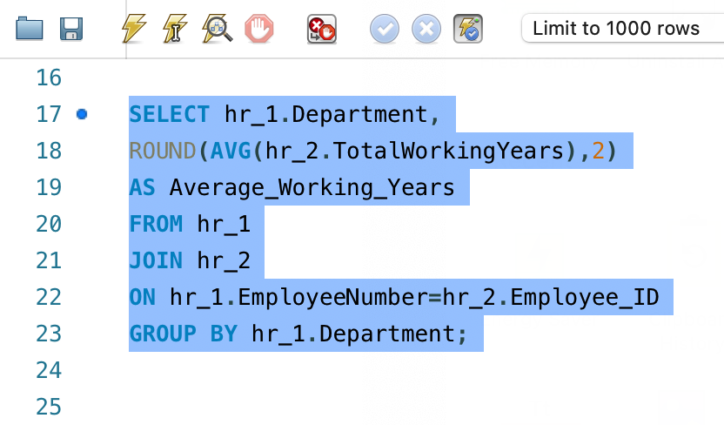
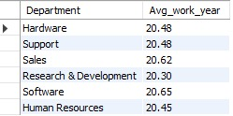
KPI-4
Insights:
The ‘Software’ department has the highest average working years at 20.65 years, while the ‘Research & Development’ department has the lowest at 20.30 years.
This could correlate with the higher attrition rate seen in ‘Research & Development’.
Recommendations:
Since the ‘Research & Development’ department also shows the lowest average working years, this reinforces the need for targeted retention efforts in this area.
Consider conducting exit interviews to gather qualitative data on why employees in this department leave earlier and use this information to create specific retention strategies.

Slide 18
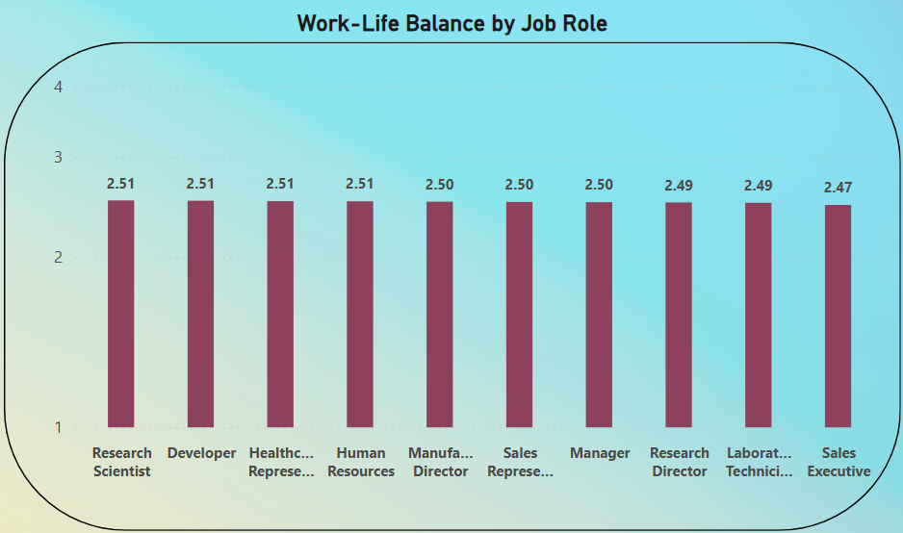
KPI-5
Insights:
All job roles have similar work-life balance scores, between 2.47 and 2.51. This indicates a relatively uniform perception of work-life balance across different roles, suggesting no single job role experiences better or worse balance than others.
The roles of Research Scientist, Developer, Healthcare Representative, and Human Resources have the highest work-life balance score of 2.51.
Recommendations:
Implement work-life balance initiatives that are tailored to the needs of different job roles. For Ex, offering flexible working hours, remote work, or job-sharing for roles like Sales Executives, where the work-life balance is slightly lower, could help improve their scores.

Slide 19
KPI-6
Insights:
There’s a noticeable increase in attrition rates as the years since the last promotion increase, with a sharp rise after 30 years.
This trend suggests that lack of promotions over time significantly impacts employee retention.
Recommendations:
Implement a structured promotion and career development plan to ensure employees are recognized and rewarded in a timely manner.
Regular reviews and clear criteria for promotions can help reduce the frustration of being overlooked, which is likely contributing to higher attrition rates.
Attrition Vs Years Since Last Promotion

Slide 20
Dashboards

Slide 21
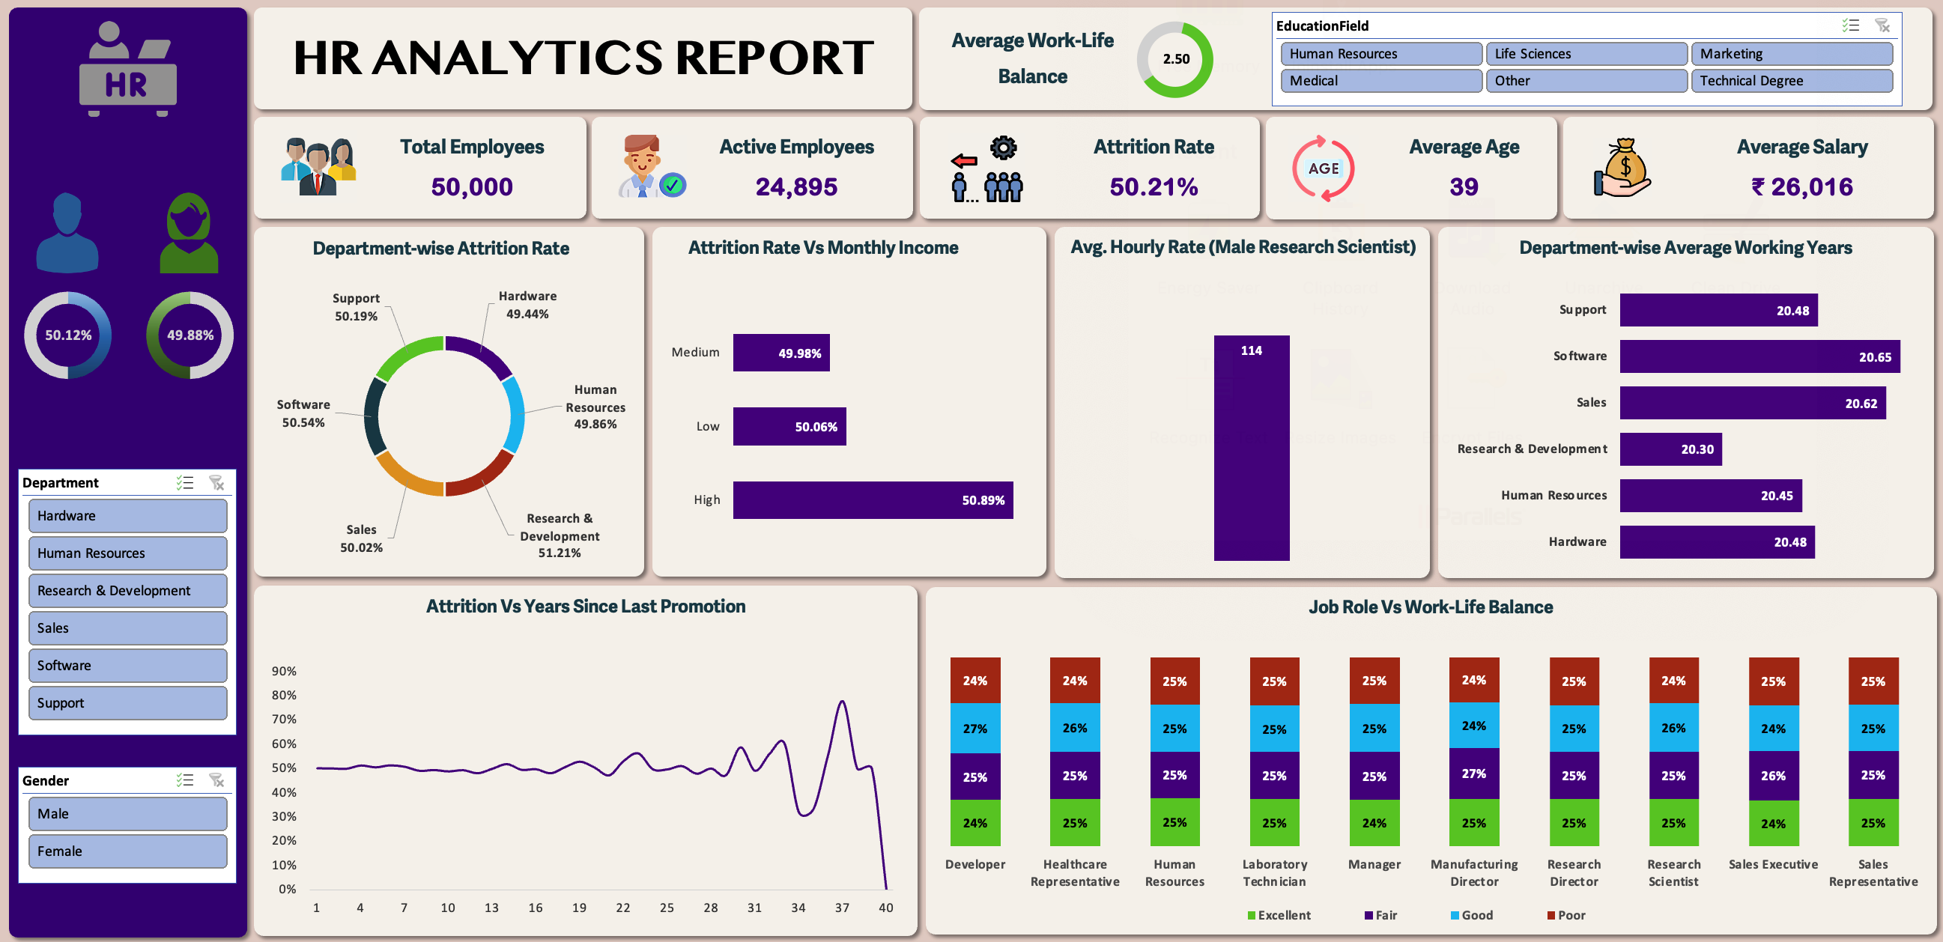
Excel

Slide 22
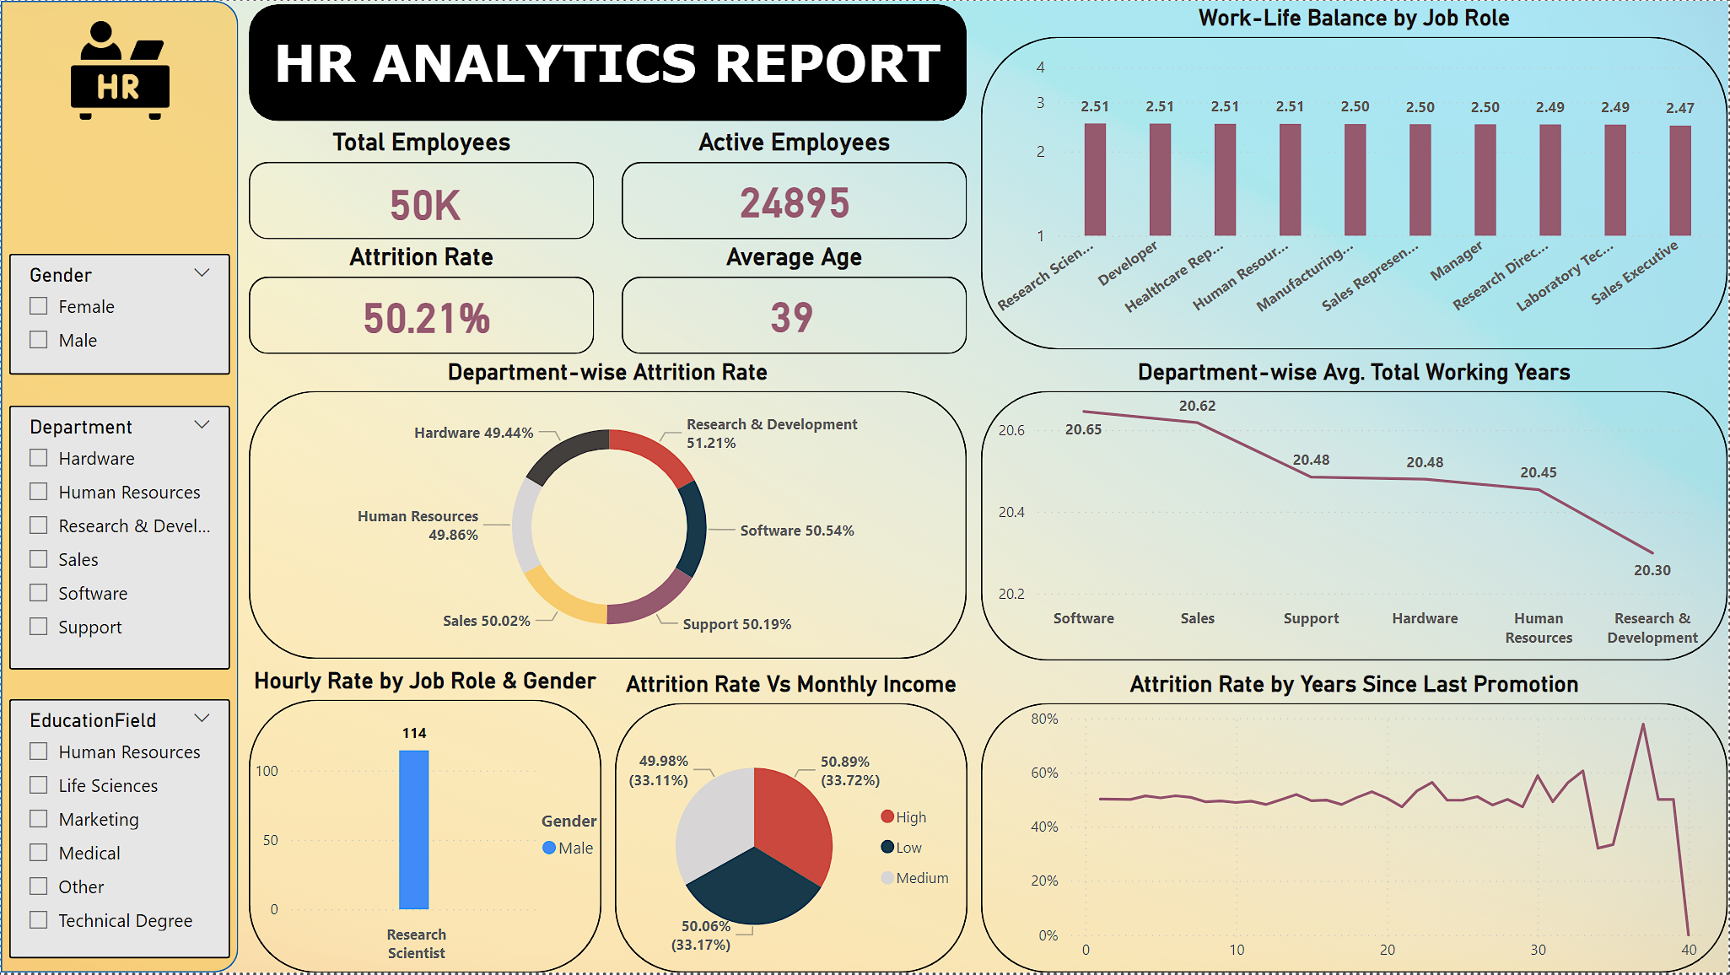
Power BI

Slide 23
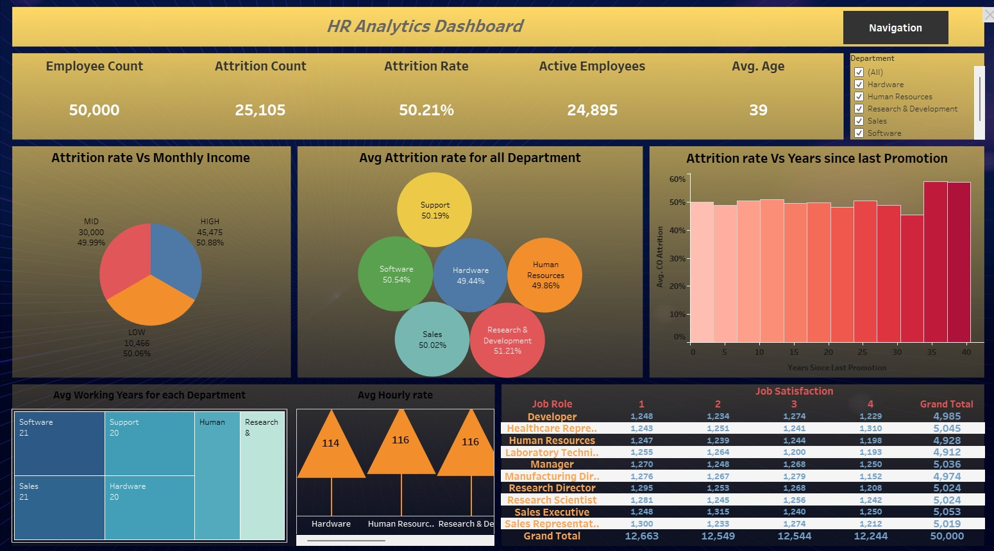
Tableau

Slide 24
Recommendations
Focus on High-Attrition Departments: Departments like Research & Development, which has the highest attrition rate at 51.21%, should be our top priority. We need to conduct deeper analysis to understand why employees in these departments are leaving and develop targeted strategies to address those specific issues. This could involve improving management practices, offering more meaningful work, or addressing workload concerns.
Enhance Work-Life Balance: With a work-life balance score of just 2.5 out of 4 and 25% of employees rating it as 'Poor', there's a clear need for improvement. Implementing flexible working hours, offering remote work options, and promoting a culture that values personal time could significantly reduce stress and increase job satisfaction, leading to lower attrition.

Slide 25
Provide Regular Career Advancement Opportunities: We’ve seen that attrition spikes around 30 years since the last promotion. To counter this, we should ensure that our employees have clear, attainable career paths with regular promotions to keep them engaged and motivated. This can be supported by mentorship programs, continuous learning opportunities, and transparent promotion criteria.
Engage Employees through Surveys: Finally, regular employee engagement surveys can help us stay aware about our workforce's needs and concerns. By actively listening to our employees and addressing their feedback, we can create a more positive work environment that encourages long-term retention. It’s important to not only gather feedback but also act on it, showing employees that their voices are heard and valued.

Slide 26
Conclusion
Conduct Stay Interviews: Focus on proactive engagement by conducting stay interviews with employees to understand their experiences and gather feedback on what keeps them satisfied in their roles.
Manage Workloads Effectively: Ensure that the workloads of employees are balanced by regularly reviewing and adjusting assignments to prevent burnout and overwhelm.
Cultivate a Positive Work Environment: Promote a workplace culture centred on respect, inclusivity, and teamwork. Encourage open communication and collaboration among all the employees.
Address Compensation and Motivation: Ensure fair compensation for the efforts of employees and explore what motivates them to stay with the organization, tailoring incentives accordingly.

Slide 27
Future Scope

Slide 28
Deep-Dive Analysis:
Conduct a more detailed analysis within departments that show high attrition rates, such as Research & Development, to identify specific drivers of turnover.
Implement qualitative methods, such as employee interviews and focus groups, to complement quantitative data. This will help uncover underlying issues such as management style, job satisfaction, and workload distribution.
Notes:
If you want to use custom background with filter:
Turn on Selection pane (Arrange > Selection pane)
Make “Placeholder” layer visible on the selection pane
Replace it with your image (click icon or drag&drop)
Make “White filter” layer visible

Slide 29
Enhanced Predictive Modeling:
Develop predictive models to identify employees at risk of leaving the organization. This could be based on factors such as years since last promotion, job role, work-life balance scores, and salary brackets.
Leverage machine learning techniques in tools like Python or R, integrating them with Power BI or Tableau for real-time monitoring. These models can help HR teams proactively address employee concerns before they lead to attrition.
Notes:
If you want to use custom background with filter:
Turn on Selection pane (Arrange > Selection pane)
Make “Placeholder” layer visible on the selection pane
Replace it with your image (click icon or drag&drop)
Make “White filter” layer visible

Slide 30
Exploring New HR Technologies:
Stay ahead of industry trends by exploring and adopting new HR technologies that can enhance employee experience and data analysis capabilities.
Research emerging HR tools and technologies, such as AI-driven recruitment software, employee wellness apps, and advanced data analytics platforms. Pilot these technologies within the organization to assess their effectiveness before full-scale implementation.
Notes:
If you want to use custom background with filter:
Turn on Selection pane (Arrange > Selection pane)
Make “Placeholder” layer visible on the selection pane
Replace it with your image (click icon or drag&drop)
Make “White filter” layer visible

Slide 31
Longitudinal Studies:
Conduct longitudinal studies to assess the long-term impact of implemented HR strategies on employee retention, satisfaction, and productivity.
Track the performance of HR initiatives over time and analyze the data to determine their effectiveness. Use these insights to make continuous improvements to HR practices.
Notes:
If you want to use custom background with filter:
Turn on Selection pane (Arrange > Selection pane)
Make “Placeholder” layer visible on the selection pane
Replace it with your image (click icon or drag&drop)
Make “White filter” layer visible

Slide 32
Validare
Thank You
For Watching & Your Attention

